Slide 1
Configuring Search in SharePoint Server 2010
Notes:
This module provides an overview of SharePoint 2010 search capabilities and discusses what search functionality is available under various SKUs. The instructor will compares and contrasts SharePoint Search architecture with the architecture of FAST Search. You will also learn how to configure the Search Service Application and to create custom search pages within a site using the Search Web Parts included with SharePoint Server 2010.

Slide 2
Agenda
Overview of Search in SharePoint 2010
SharePoint Search Architecture
FAST Search Architecture
Configuring SharePoint Server 2010 Search
Additional Search Capabilities

Slide 3
SharePoint 2010 Search Products and SKUs
SharePoint Foundation Search
enables searches scoped to site collection
Search Server and Search Server Express
enables searches on external content source
does not include other SharePoint server features
SharePoint Server Search
enables searches on external content source
integrates search features with other SharePoint Server services
integrates with User Profile Service to enable People Search
FAST Search Server 2010 for SharePoint
separate product that installs on top of SharePoint Server 2010
provides advantages in content searches over SharePoint Server Search
currently, there is no support for people searches
Notes:
If information is indexed and made available for searching then it will have results presented back to the user who initiates the query of that information.

Slide 4
Search 101
How does SharePoint Search Work?
SharePoint crawls content
SharePoint builds search index
Query is executed by user
Query is compared against index
Search results are served to user
* Search honors security if properly configured

Slide 5
What can be indexed?
The following can be defined as content sources
SharePoint sites
File shares
Web sites
Microsoft Exchange public folders
Databases
Line-of-Business applications
Notes:
File Shares:There are some folks that say they want SharePoint to be there new file share for the corporation. What they don’t grasp is that file shares can be put together in such a way that you have duplicate information, old information, junk, no structure… etc.
Companies sometimes think SharePoint is the answer but in reality in these situations your moving junk from one location and creating a junk pile in another. Without careful planning and pruning of this information you are not really solving a problem… just creating a new one.
Giving SharePoint the ability to search File Shares will give users the same benefit ( Results returned based on Security Trimmed information) If this is done then planning can be done to properly go through the information and move it properly into SharePoint for collaboration purposes.
Keep the junk in the File Share realm. Move the golden data into SharePoint after proper planning

Slide 6
Search Architecture and Terminology
Key pieces to search infrastructure
The Gatherer
Content Sources
Connectors and Protocol handlers
IFilters
Index Files
Notes:
Search Architecture Terminology:
Content source: This is the place where the content lives. A content source can be a WSS site or a Window File Share.
Connector: This is the code that allows the SharePoint index service to reach across the network and retrieve the content to be indexed. Connectors are new in SharePoint 2010.
Protocol Handler: This is the older style of code that allows the SharePoint index service to reach across the network and retrieve the content to be indexed. It is recommended to use Connectors but protocol handlers are supported for backwards compatibility.
IFilter: A COM-based DLL able to parse a file and convert it into a UNICODE character array. You must have a IFilter for each type of file you want to search through. For example, Microsoft provides IFilters for Office documents and Adobe provides an IFilter for PDF files.
Gather: This is the main component responsible for retrieving content and moving it through the process to build indexes.
Wordbreaker: Language-specific component that tokenizes text into words.
Stemmer: Language-specific component that find derivations of a word. For example, the stemmer will determine that running, runs and ran are all derivations of the word run that should be incorporated in search results.

Slide 7
Changes When Moving from 2007 to 2010
You configure multiple indexers
Crawl Database doesn’t Impact Queries
Add new Crawl Databases as Needed
Index Servers are Stateless Crawlers
Index can be Partitioned
Multiple Property Databases
Admin Database
Admin Components

Slide 8
Search User Experience
Search Center
Scopes
Web parts
Query federation
Core search experience
Metadata
Results refinement
"View in browser" link (for most office docs)
Improved query syntax
Search from mobile devices
Notes:
View in Browser works only if you have Office Web Application (OWA) set up in the environment. OWA is also required if you want to see Document Previews in the search results pane.

Slide 9
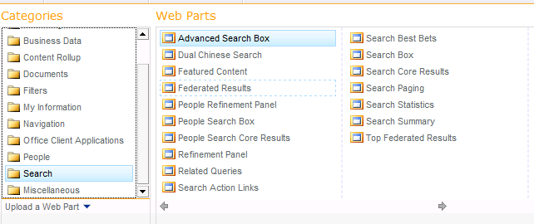
Web Parts
Notes:
Note: with the exception of Dual Chinese Search, most of these web parts are already incorporated on the search master page so unless you want to customize what your users can see this work of setting up the search site is largely done already.

Slide 10
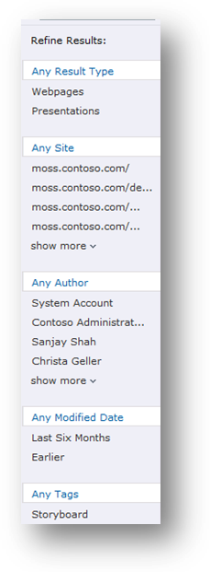
Search Refinements
Displayed left side of results page
Self-service drill-down
Automatically determined using tags and metadata
Examples:
Type of content
Location
Author
Metadata tags
Notes:
In the early stages of your deployment this results section will be fairly empty. As more tags and such are added to the environment this area will grow. There is no customization needed on this section unless you are looking to remove some of the header items.

Slide 11
Query Syntax
Support for Boolean operators for FreeText queries and Property Queries
(“SharePoint Search” OR “Live Search”) AND (title:”Keyword Syntax” OR title:”Query Syntax”)
Prefix matching support for keywords and properties
Share* author:shane*
Improved operator support for property restrictions
=,>,<,<=,>=

Slide 12
Relevancy
Relevancy formula has been enhanced
Additional text fields included
URL fuzzy matching
Results click through
Notes:
URL Fuzzy Matching is a String Comparison Mechanism for example: http: //www.yahoo.com/groups/*/member/*.htm

Slide 13
Enhanced Multi-lingual support
Automatic detection of language for many document types
Improved ranking of document in multilingual collection
Compound word handling - e.g., “Innovationszyklen” and ”innovation“, “zyklen”

Slide 14
Search from other places
Windows 7 Desktop Integration
Mobile Search
Office Clients
Notes:
With Windows 7 Desktop Integration we now have the ability to pull search results directly onto our desktops without having to launch the SharePoint Search site page.

Slide 15
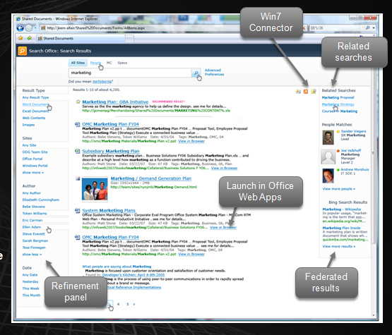
Search UI

Slide 16
DEMO
Search Experience

Slide 17
Social integration with search
People finding experience
Front door to the Office social network
Better expertise & interest search
Email mining
“Address book style” search
Phonetic name matching
Nickname matching
Relevance models tuned for people search
Notes:
Note: Email Mining
Back in the early days of SharePoint 2007 there was a quiet product that was being considered for launch called Knowledge Networks. One of the add ins that KN brought was a client side application that would go through your email headers and look at who you were talking to about with different topics. The tool was not actually indexing the content of the mail but actually just looking at the conversation points which when used with People Search would tell the person running the query …. Im searching for this person… but I see this other person also has some experience with my query. Thus bringing the concept of social distance through returned search results into the picture.
KN never made it to market but instead Microsoft rolled portions of this tool directly into SharePoint 2010. Also note that in the previous version (KN) you could have return results for people outside your organization. This capability has appeared to be removed in 2010 so you can now only find people within your own organization… or if you are federating with another company you would find their information as well

Slide 18
Social integration with search
Social behavior drives search quality
Search click through behavior drives relevance ranking
Query suggestions mined from search logs
Social tagging influences relevance ranking
Self search - to drive people to participate content

Slide 19
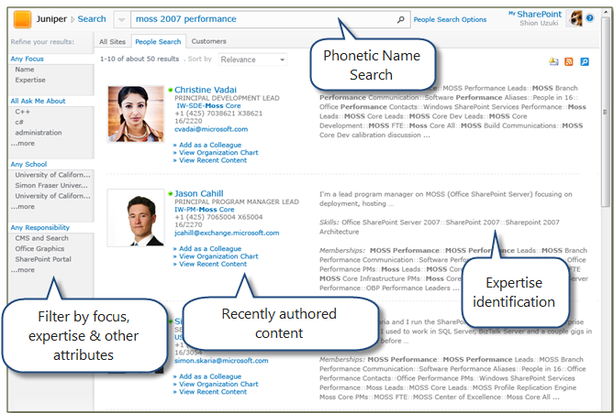
People Search

Slide 20
DEMO
People Search

Slide 21
Search Architecture
Support for scalable topology
Scales to approximately 100 million items
Support for Multi-tenant hosting environment
Improved redundancy
Search is now a Service Application.

Slide 22
Search as a Service Application
More flexible shared service model compared to previous version
Allows a set of services to be associated with a given Web application
Same service can be configured differently between two different Web applications

Slide 23
Scalability
High performance
Fresh indexes
Better redundancy
Need more performance?
Add more servers to reduce bottlenecks

Slide 24
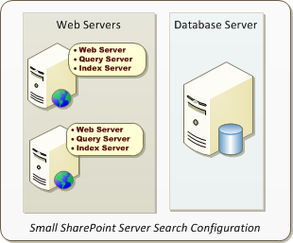
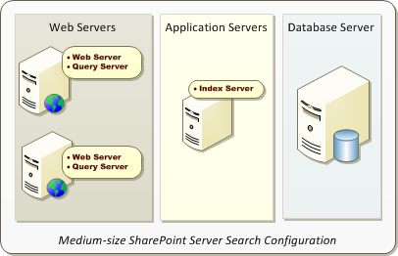
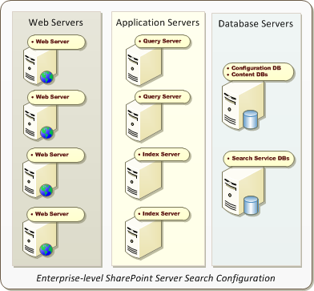
SharePoint Server Search Configurations
SharePoint Server Search is scalable
Many different topologies and configurations possible

Slide 25
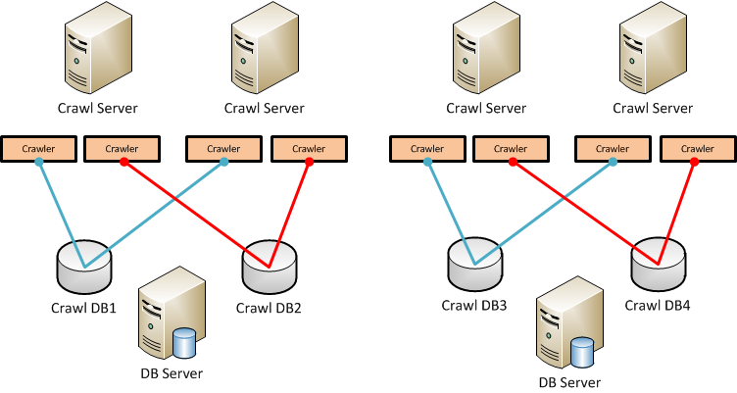
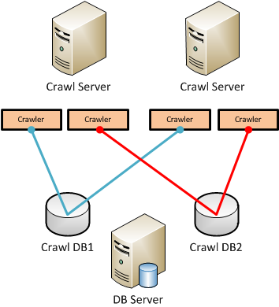
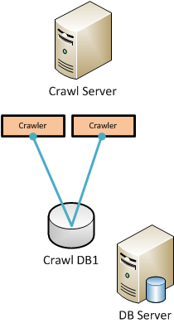
Crawler Component & DB
Notes:
Crawl Component Failover
Crawl failover is automatic and always enabled. A message will be displayed on the Topology Management page when failover occurs. There are two types of failover, one for Master Crawl Components and one for normal Crawl components.
How failover works
The Master crawl component updates its status every minute, and each crawling component checks to ensure that the status is updated. If the master crawl component fails to update its status for 30 minutes, the first component to check will assume the role of the Master.
The crawl component update works in a similar fashion. Every crawl component updates its status every minute, and the Master component checks to ensure that every component is updating its status. If it detects that a component has not updated its status for 30 minutes, that component is removed from the topology and replaced.
The Master crawl component follows this logic to determine which component should replace the failed component:
Randomly pick a component from the list of idle components.
If there are no idle components, select the component that is nearest the end of its crawl.
If all crawls are “equal”, then randomly select one.
Recovering from failure
When a failed component is repaired and restored to the farm, it will resume the association with its crawl database and resume crawling documents.
If the failed component was the master component, it will NOT resume the role of master, but will remain a normal crawl component.

Slide 26
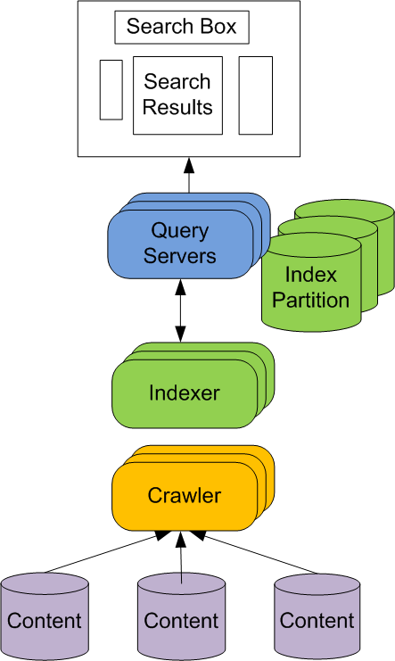
Scalable Architecture
Search Center – Site where users issue queries and get results
Query Servers – Accept query requests and serve results to users
Query Federation – Return results from non-SharePoint Indexes
Indexing – Extract information from content to enable efficient matching
Index Partition – Subset of index
Crawling – Process of building index
Content Sources – Where the content lives

Slide 27
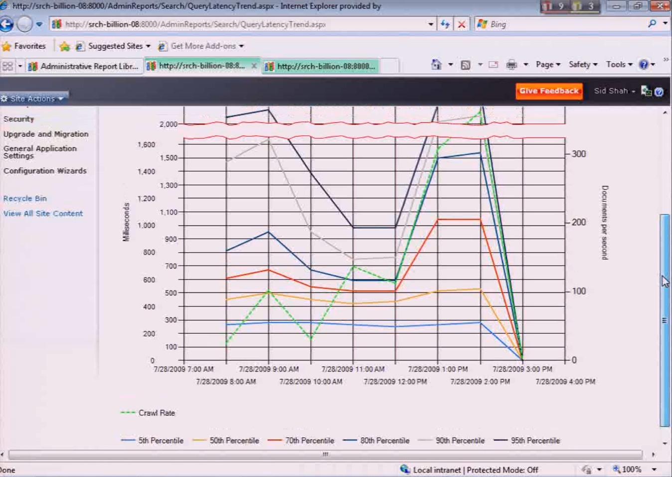
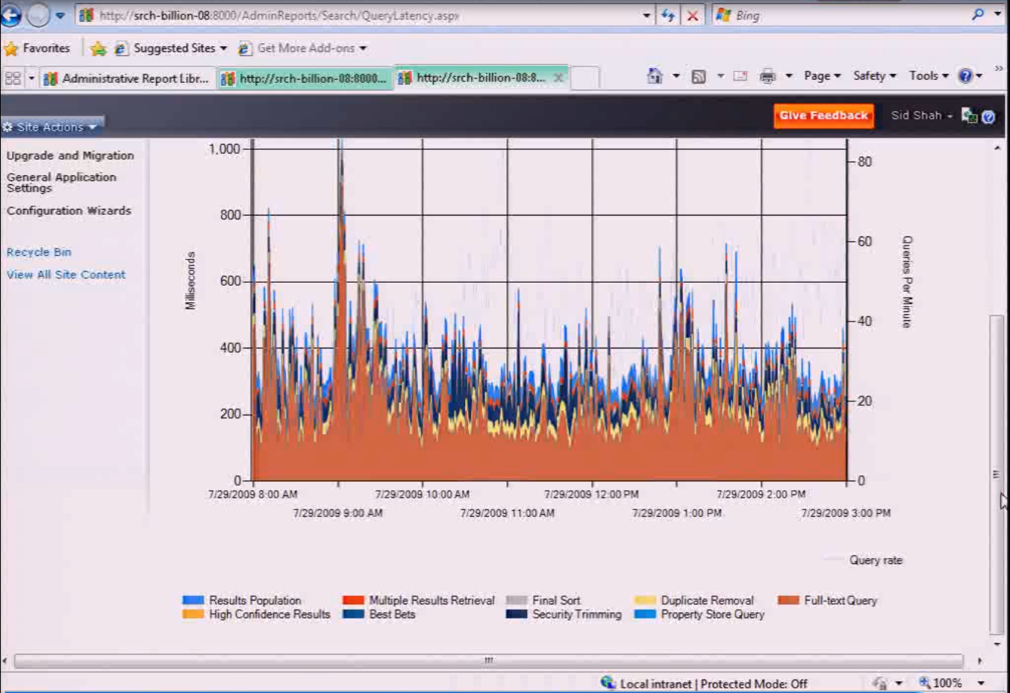
Search Reporting and Monitoring
Query Latency
Query Breakdown

Slide 28
Other Search goodies
Support for regular expressions in Crawl Rules
Ability to natively crawl case sensitive repositories
Content Sources can be prioritized to distribute crawl load
Reduced downtime for search during backups
Developers can leverage search

Slide 29
DEMO
Search Administration

Slide 30
FAST Search for SharePoint
High end enterprise search for SharePoint
Ideal for highly complex queries
Ex. Custom search of a product catalog from LOB system
FAST handles content queries
SharePoint Search handles People Searches

Slide 31
More FAST
Built on .NET
Integrated into SharePoint OM
Replaces the SharePoint Content Pipeline when installed
Still uses SharePoint Search for People search
Extends the OOTB SharePoint web parts
Understands 82 languages
Document boost allows your to increase relevancy
Contextual Searches based on user property
Extractors allow FAST to pull undefined metadata

Slide 32
Summary
Powerful search UI
Lots of options for getting to the content you are looking for
Search is social
Scalable search architecture
Even more options with FAST

